Slide 1

4
Spotify
3
2
Clone Project
1
Website
Using HTML,CSS & Java Script

Slide 2
Submitted by: GU_FE_TEAM09
ANIKET KUMAR THAKUR (22SCSE1011967)
ANCHAL KUMARI (22SCSE1010680)
SIMRAN CHAUHAN (22SCSE1011148)
ANAS AHMAD (21SCSE1011096)
KARTIK RANA (22SCSE1010755)
GUNJAN (21SCSE1011282)
GURJAS KAUR (21SCSE1180218)
BISHAL PAUL (21SCSE1010468)
GOVIND KUMAR (22SCSE1012853)
4
3
2
1
PROJECT IS DONE UNDER THE GUIDANCE OF IBM, AND GALGOTIAS UNIVERSITY

Slide 3
INTRODUCTION
This project is a clone website of popular music application of SPOTIFY. This project give us a demo about the visuals, graphics and the system used by Spotify . The main purpose behind developing this project was to understand the working of the existential systems and applying our learning skill.
SPOTIFY is a digital music, podcast and video
streaming service that provides you with access to million of songs and other content from artist all arround the world.
4
3
2
1

Slide 4
PROBLEM DEFINITION
To design a simple Music Player. Study of the existing system. Drawbacks of existing system.
Scope of Proposed System.
4
FEASIBILITY STUDY
3
TECHNICAL FEASIBILITY :
language used are HTML CSS & JAVASCRIPT.
Demo dataset of the songs is taken from the internet sources.
ECONOMICAL FEASIBILITY :
It is cost effective.
Cost/Benefit Analysis.
2
1
TECHNICAL REQUIREMENTS
HARDWARE : CODING STYLE :
HTML RAM: Min 4GB
CSS Processor: Intel Core i5
JS

Slide 5
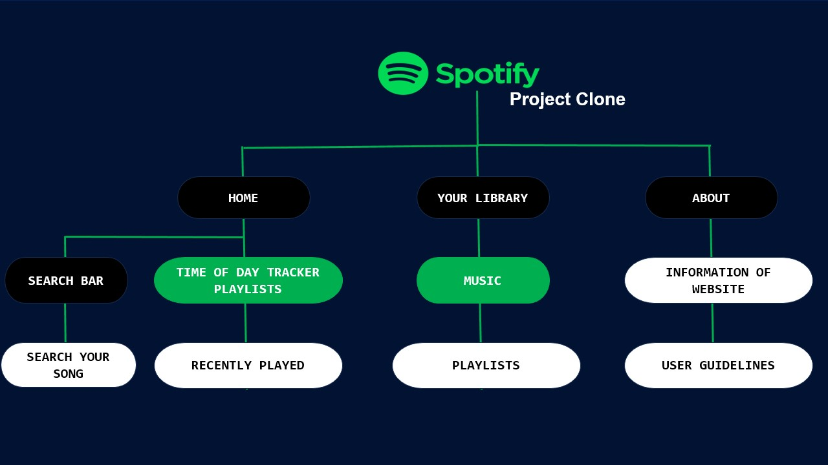
SITE MAP
4
3
2
1

Slide 6
GATHERING DATA & FUNCTIONALITY
REQUIREMENTS
IDENTIFY STAKEHOLDERS OF THE SYSTEM :
Project manager
Customer
User
Developer
Tester
4
3
INPUT DATA OF THE SYSTEM :
Music 1 - Music 2 - Music 3
Output information of the system :
Plays the songs
FUNCTIONAL/ PROCESSING OF THE SYSTEM :
Processing requirements :
Requires the internet connection in the system.
Needs the browser to the start the music player.
2
1

Slide 7
4
Spotify
THANK YOU
3
Clone Project
2
1

